Slide 1
Unit IV - Development Tools for Embedded System
CSPC61 - Embedded Systems Architectures
Dr. M. Bhuvaneswari
21.04.2022

Slide 2
Developmental Tools for Embedded System
Advancement in technology helped in making things simpler and easy to operate.
Many electrical and electronic circuits and kits are designed using embedded systems.
An electronic system integrates the hardware circuitry with the software programming techniques for providing solutions for a real world problem.
Integration of hardware and software to perform a specific operation is an embedded system.
Embedded system technology, the complexity of the circuits can be reduced to a great extent which further reduces the cost and size.
Different development tools can be used to design embedded system.
Editor, compiler, assembler and debugger.

Slide 3
Embedded System Software Development Tool
Text Editor - First tool need for Embedded Systems Software Development.
Code is written using programming languages like C or C++ - Source Code.
Compiler - To translate the computer code written in high level programming language into assembly language, object code or machine code - to create executable program.
Cross compiler - Compiler capable of creating executable code for a platform other than the one on which the compiler is running.
A bootstrap compiler (self hosting compiler) is written in the language that it intends to compile. It can compile its own source.
Bootstrapping is a process to create a new cross compiler.
A program that translates from a low-level language to a higher level one is a de-compiler.

Slide 4
Embedded System Software Development Tool
Assembler - to convert a code written in assembly language into machine language.
A linker is a software that combines one or more object code files and library files together in to executable program.
A library is a collection of implementations of behavior that has a well-defined interface by which the behavior is invoked.
Designers who want to write a higher level program may use a library to make system calls, instead of implementing those system calls.
Debugging is primarily the task of locating and fixing errors within the system.
Debugging tool can be used to track down and correct bugs in the system.
Simulators help to see how code will work in real time, how sensors are interacting, can see how the components are working and how changing certain values can change parameters

Slide 5
IDE - Developmental Tools for Embedded System
An Integrated Development Environment is a software which contains all the necessary tools required for embedded software development.
To create a software for embedded system, we may require all tools - from writing to testing of code.
An IDE normally consists of a code editor, compiler and a debugger.
Few simulators - design of embedded system
Arduino IDE, MATLAB, Keil, LabVIEW, Pspice, EasyEDA, Proteus, Altium, MPLab
Embedded system programmed or non-programmed to operate, organize, and perform single or multiple tasks based on the application.
Hardware organization and software configuration and interfacing are very important

Slide 6
Unit V - Implementation and Testing, Implementing the Design, Debugging
CSPC61 - Embedded Systems Architectures
Dr. M. Bhuvaneswari

Slide 7
Implementing the Design
Explicit architecture documentation helps the engineers and programmers - to implement an embedded system that conforms to the requirements.
Development tools - The development and integration of an embedded system’s various hardware and software components.
Embedded systems implementation - at least one other computer system connected to the embedded platform to manage development of that platform.
Development environment – target and host
Target - Embedded system being designed
Host – a computer system where the code is actually developed.
Development tools in embedded design can be located on the host, on the target, or can exist stand-alone.
Three categories: utility, translation, and debugging tools

Slide 8
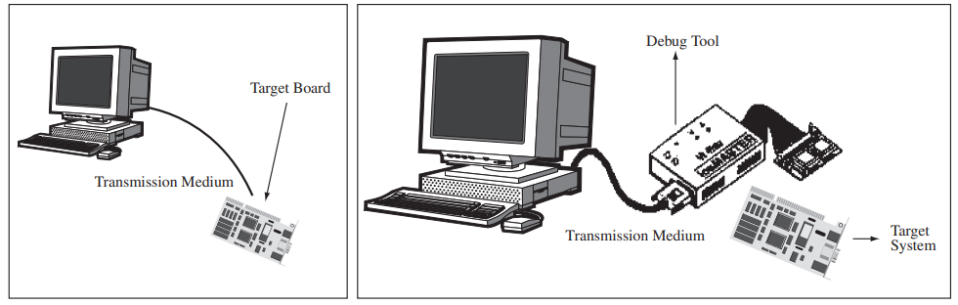
Implementing the Design
Utility tools are general tools that aid in software or hardware development.
Editors (for writing source code), VCS (Version Control Software) that manages software files, ROM burners that allow software to be put onto ROMs.
Translation tools convert code a developer intends for the target into a form the target can execute.
Debugging tools can be used to track down and correct bugs in the system.
Development environments

Slide 9
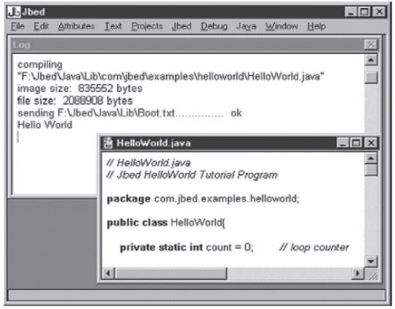
Main Software Utility Tool - Editor or IDE
Source code is written with a tool - standard ASCII text editor, or an Integrated Development Environment (IDE) located on the host.
An IDE is a collection of tools - an ASCII text editor, application user interface.
Any ASCII text editor can be used to write any type of code, independent of language and platform.
An IDE is specific to the platform
IDE’s vendor
a hardware manufacturer
OS vendor
language vendor
IDE

Slide 10
Main Software Utility Tool - Editor or IDE
Source code is written with a tool - standard ASCII text editor, or an Integrated Development Environment (IDE) located on the host.
An IDE is a collection of tools - an ASCII text editor, application user interface.
Any ASCII text editor can be used to write any type of code, independent of language and platform.
An IDE is specific to the platform
IDE’s vendor
a hardware manufacturer
OS vendor
language vendor
IDE

Slide 11
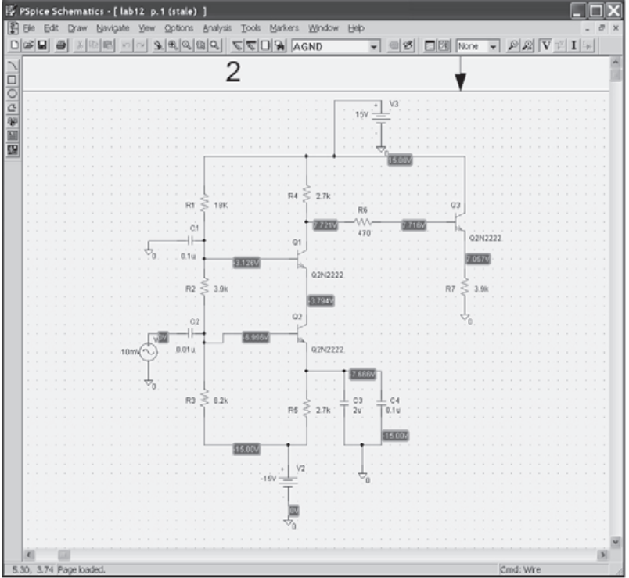
Computer-Aided Design (CAD) and the Hardware
CAD tools are commonly used by hardware engineers
To simulate circuits at the electrical level in order to study a circuit’s behavior under various conditions before they actually build the circuit.
SPICE (Simulation Program with Integrated Circuit Emphasis)
University of California, Berkeley
PSpice is the PC version of SPICE.
Several types of circuit analysis
Nonlinear transient
Nonlinear DC,
Linear AC,
Noise, and distortion
PSpice

Slide 12
Computer-Aided Design (CAD) and the Hardware
CAD tools are commonly used by hardware engineers
To simulate circuits at the electrical level in order to study a circuit’s behavior under various conditions before they actually build the circuit.
SPICE (Simulation Program with Integrated Circuit Emphasis)
University of California, Berkeley
PSpice is the PC version of SPICE.
Several types of circuit analysis
Nonlinear transient
Nonlinear DC,
Linear AC,
Noise, and distortion
PSpice

Slide 13
Computer-Aided Design (CAD) and the Hardware
Because of the importance of and costs associated with designing hardware - many industry - CAD tools are utilized to simulate a circuit.
Given a complex set of circuits in a processor or on a board - Difficult - to perform a simulation on the whole design.
At the highest level, a behavioral model of the entire circuit is created - to study the behavior of the entire circuit.
Behavioral model can be created with a CAD tool.
Depending on the type of the circuit, additional models are created down to the individual active and passive components of the circuit

Slide 14
Computer-Aided Design (CAD) and the Hardware
Tableau approach or modified nodal methods can be used for writing the circuit equations for a specific simulators.
To simulate complex circuit
dividing more complex circuits into smaller circuits, and then combining the results.
utilizing special characteristics of certain types of circuits.
utilizing vector-high speed and/or parallel computer

Slide 15
Translation Tools
After the source code has been written - translated into machine code.
Machine code is the only language the hardware can directly execute.
This mechanism includes one or some combination of preprocessing, translation, and/or interpretation machine code generation techniques.
Some tools used in translating code - preprocessors, interpreters, compilers, and linkers.
Preprocessor - to organize and restructure the source code to make translation or interpretation of this code easier.
can be a separate entity, or can be integrated within the translation or interpretation unit

Slide 16
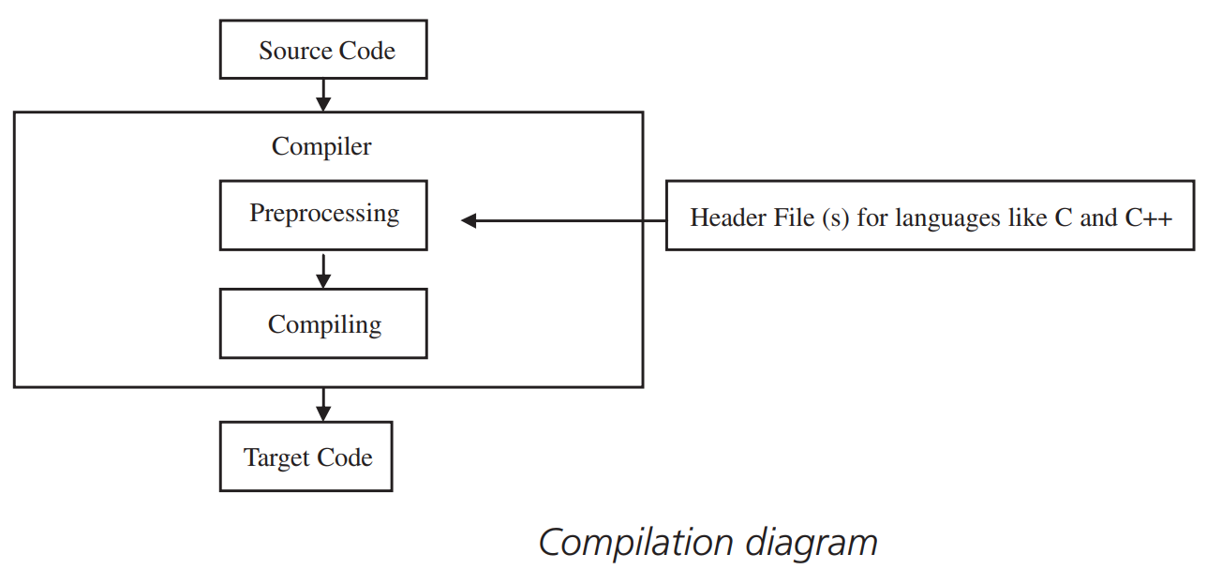
Translation Tools
Many languages convert source code, either directly or after having been preprocessed, to target code through the use of a compiler.
A compiler translates all of the source code to a target code at one time.
Embedded systems – compilers - programmer’s host - generate target code for hardware platforms that differ from the platform the compiler is actually running on.
Cross compiler
After compilation is completed
object file

Slide 17
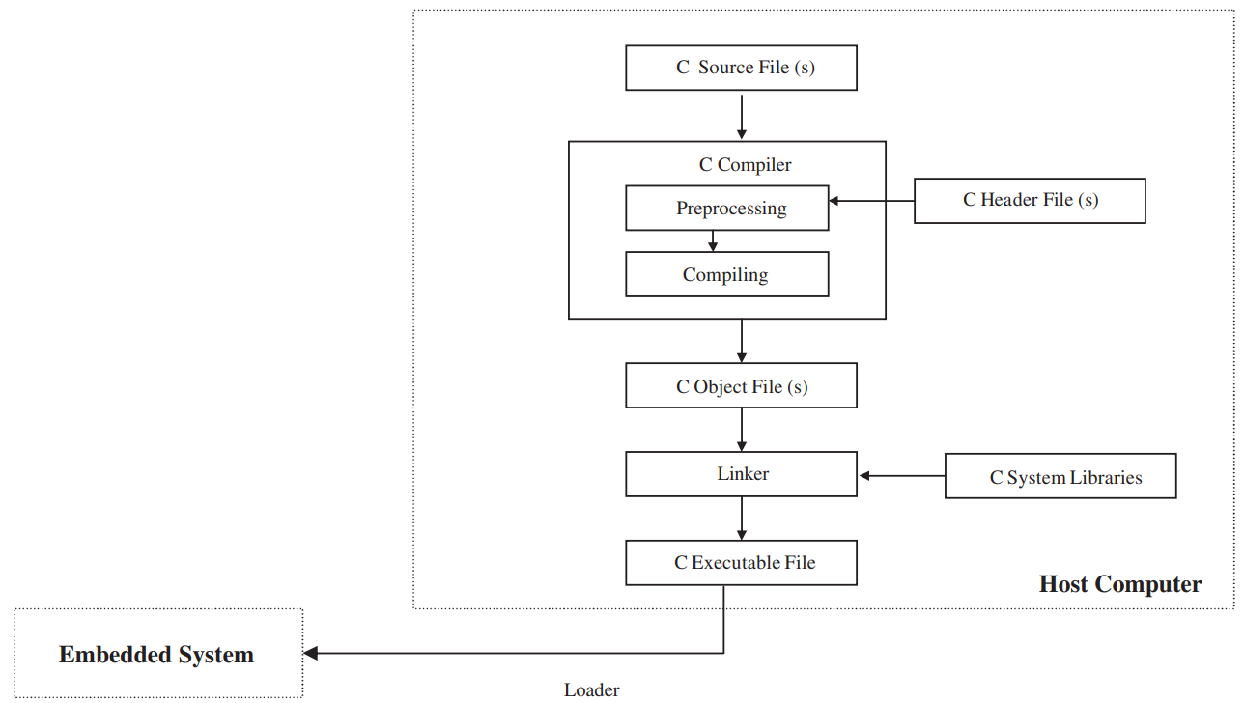
Translation Tools
Linker integrates this object file with any other required system libraries, creating an executable binary file.
It will be stored directly onto the board’s memory or ready to be transferred to the target embedded system’s memory by a loader.

Slide 18
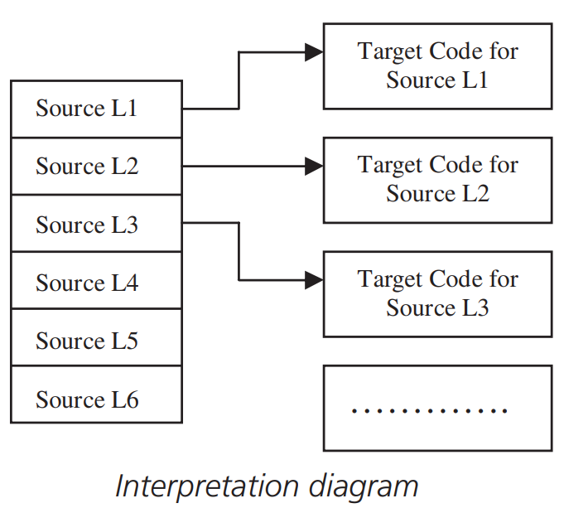
Translation Tools
IDE, preprocessors, compilers, linkers and so on reside on the host development system.
Compilers or interpreters located on the target.
An interpreter generates (interprets) machine code from source code.
one source code line at a time.

Slide 19
Debugging
Debugging code is probably the most difficult task of the development cycle.
Debugging is a task of locating and fixing errors within the system.
Task is made simpler - programmer - familiar with the various types of debugging tools available and how they can be used.
Debugging tools reside and interconnect in some combination of standalone devices, on the host, and/or on the target board.
In-Circuit Emulator (ICE), ROM Emulator, Background Debug Mode (BDM), Background Debug Mode (BDM), IEEE-ISTO Nexus 5001, Oscilloscope, Logic Analyzer, Voltmeter, Ohmmeter, Multimeter – Hardware
Debugger, Profiler, Monitor, Instruction Set Simulator – Software
Print Statements, Dumps, counters/timers, fast displays, output ports - Manual

Slide 20
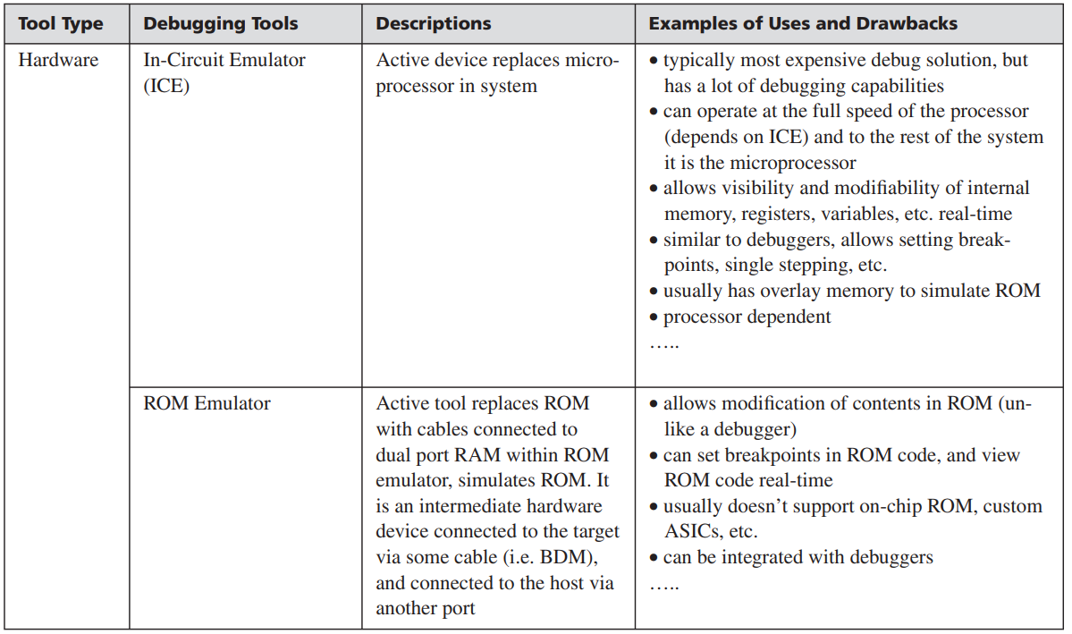
Debugging Tools - Hardware

Slide 21
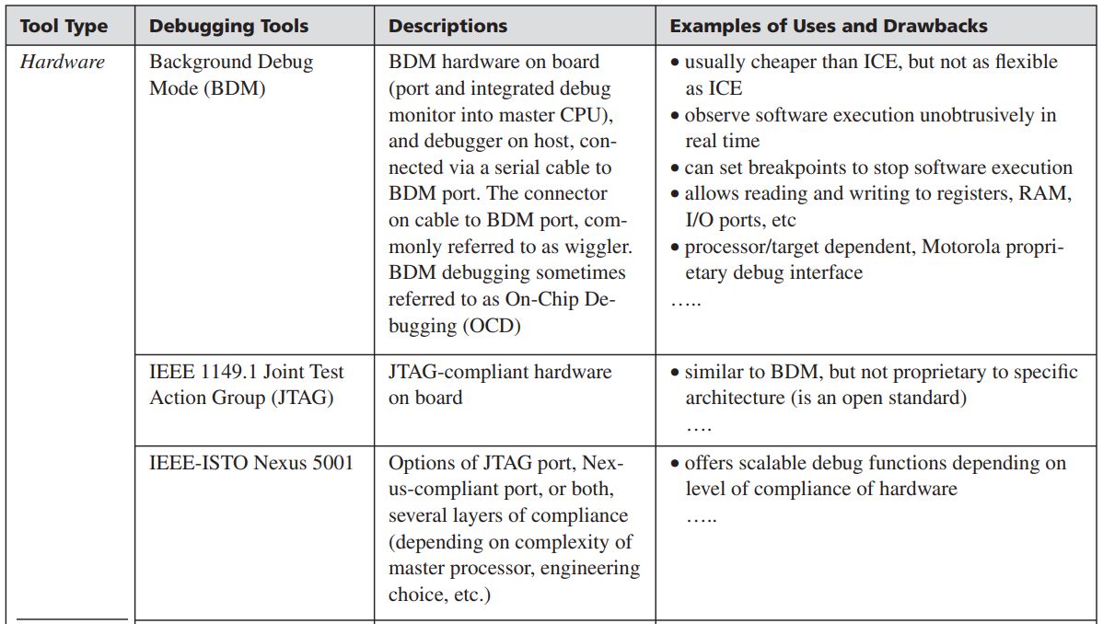
Debugging Tools - Hardware

Slide 22
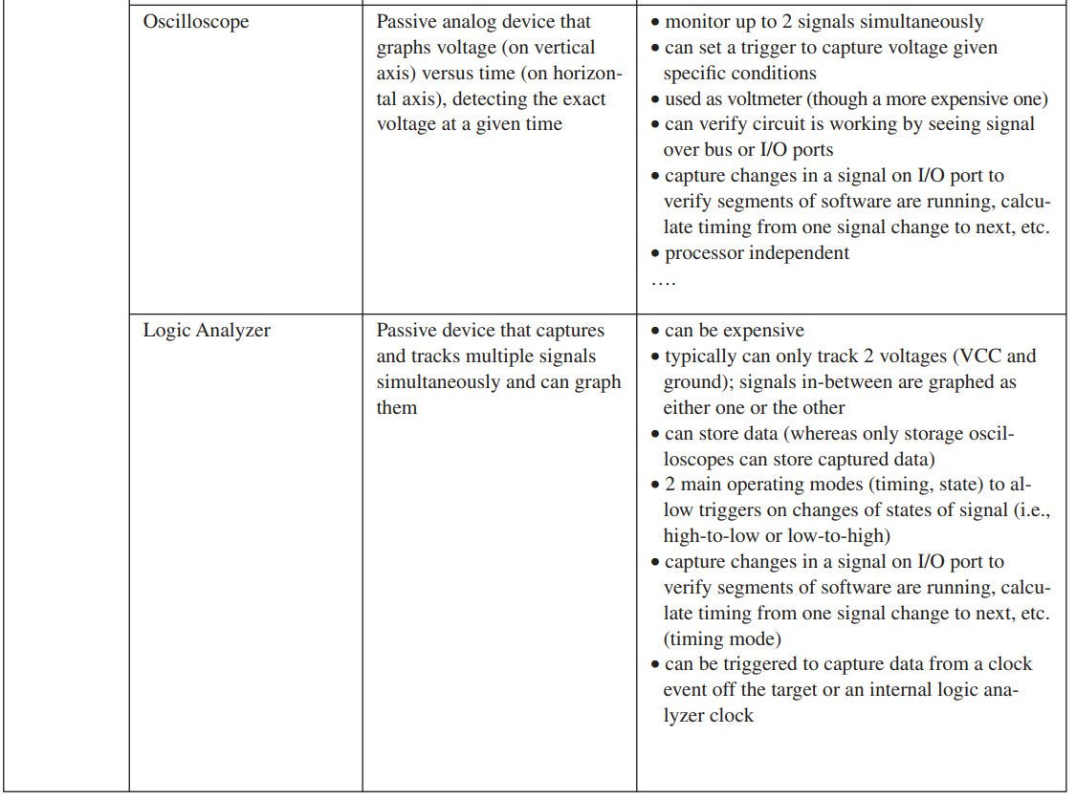
Debugging Tools - Hardware

Slide 23
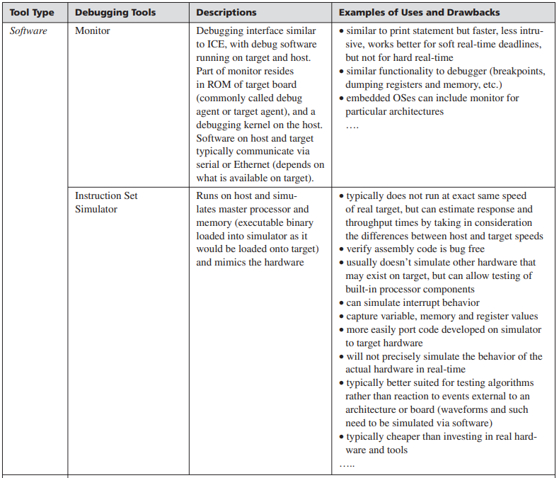
Debugging Tools - Software

